Slide 1
Used Cars Price Analysis
Presented by :
sagar baditya

Slide 2


Introduction
The used car market in India has witnessed significant growth in recent years, driven by the rising demand for affordable personal transportation and growing trust in pre-owned vehicle platforms.
With a wide variety of brands, models, and price segments available, the market caters to diverse consumer needs, making used cars a practical and popular choice in both urban and rural areas.
This project aims to analyze the prices of used cars across India using data collected from platforms like Spinny. The primary objective is to explore how car prices vary based on brand, fuel type, transmission, and other key features.

Slide 3






Web Scraping and Data Collection
Website Used
Data was extracted from Spinny.com, a prominent platform for used car listing.
Key Data Points
Focused on extracting car model, year of manufacture, driven, fuel type, transmission, and location.
Python Library
Used selenium for dynamic browsing,
BeautifulSoup for HTML parsing, Pandas for data handling.
Data Accuracy
Implemented measures to verify the accuracy and completeness of the scraped data.
Saved
Saved the dataframe into .csv format using Pandas, forming the foundation for further cleaning, transformation, and visualization.

Slide 4

Removed duplicate entries to avoid data repetition.
Handled missing values by removing or imputing them.
Corrected data types using Power Query (e.g., text → number).
Standardized values (e.g., fuel types, car brands).
Utilized Power Query to streamline the data transformation process.
Data Cleaning and Transformation

Slide 5

Visualization & Dashboards
Create interactive dashboards and visualizations for analyzing used car data across various dimensions using Power BI
Utilized within Power BI to create custom measures and calculations for deeper insights.

Slide 6
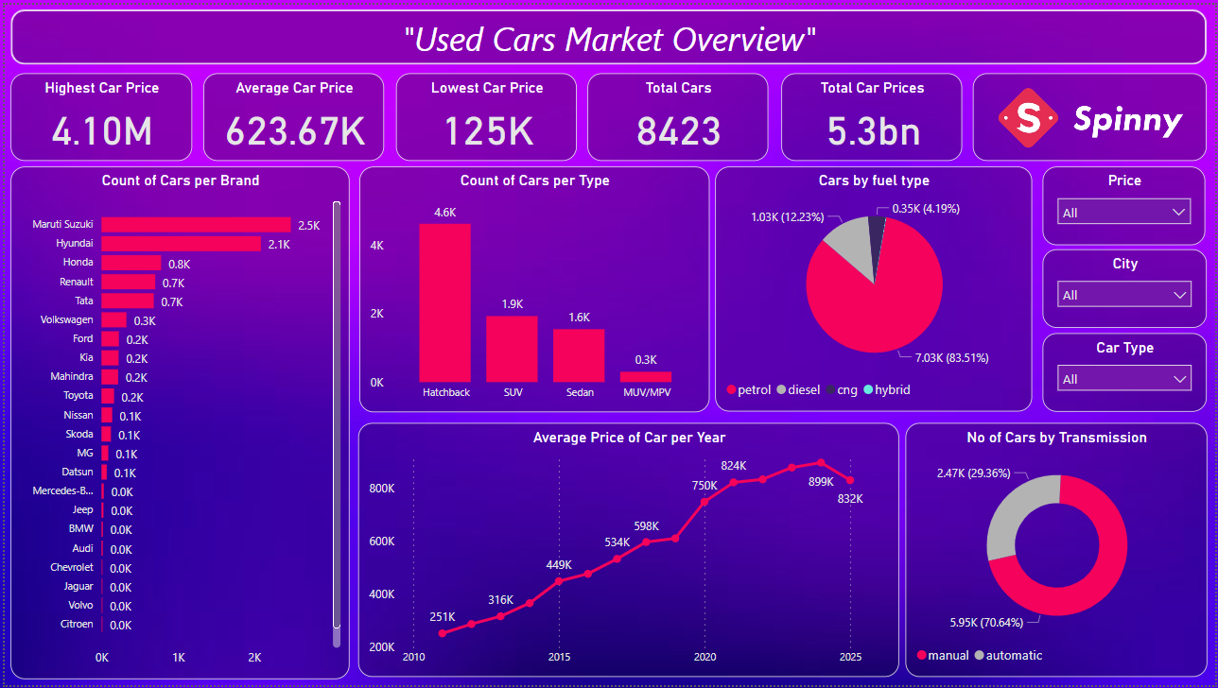

DASHBOARDS

Slide 7
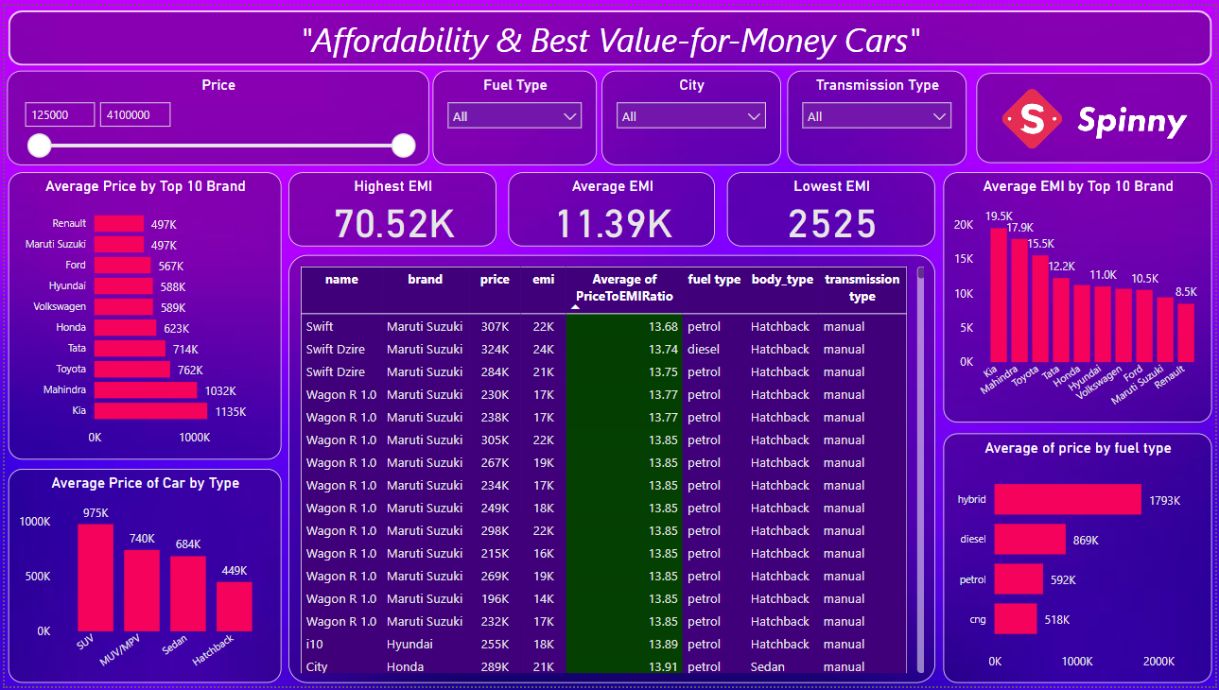
DASHBOARDS

Slide 8

Conclusion
The used car market in India is diverse, with varying prices across different brands and segments.
Affordable brands like Maruti Suzuki, Honda, and Hyundai offer the best value, with stable prices and minimal depreciation.
Premium brands, such as BMW and Mercedes-Benz, have higher resale values but show more price volatility.
EMI options are crucial for making higher-priced cars more accessible, providing flexible repayment terms.

Slide 9
THANK YOU

